Slide 2
Learning Objectives
At the end of the lesson, the learners must have:
Identified the different indicators and determinants, and components of economic development
Examined the current situation of Philippine’s economic development
Discussed possible solutions on socio-economic issues the Philippines is facing

Slide 3
Lesson Outline
Land and other Natural Resources
Physical Capital
Labor and Human Capital
Organization (Management and Administration)
4. Technology
Scale (Capacity of Economy, Structural Change)

Slide 4
Lesson Outline
Indicators and Determinants
1. Health and Nutrition
2. Learning
3. Income and Consumption
4. Employment
5. Housing and Utilities

Slide 5
Lesson Outline
Indicators and Determinants
4. Public Safety
5. Political Values
6. Social Mobility

Slide 6
Components of Economic Development

Slide 7
Abundant Natural Resources

Slide 8
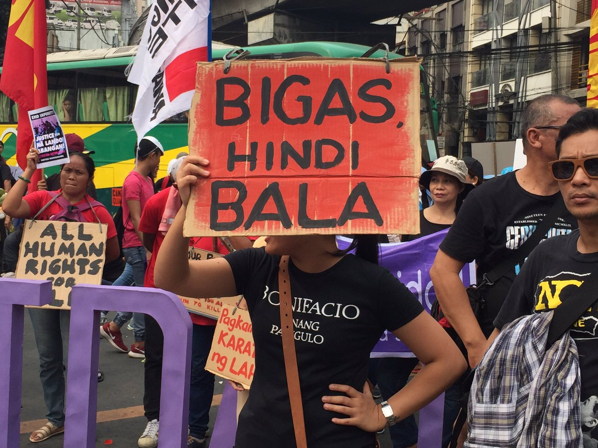
Sufficient Palay Supply
https://twitter.com/

Slide 9

Affordable Rice
https://newsinfo.inquirer.net/

Slide 10
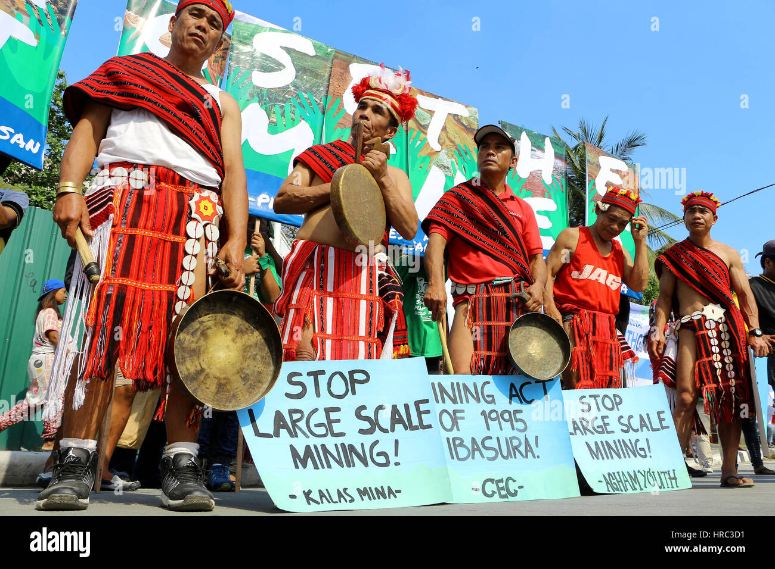
Export-quality Minerals
https://www.alamy.com/

Slide 11
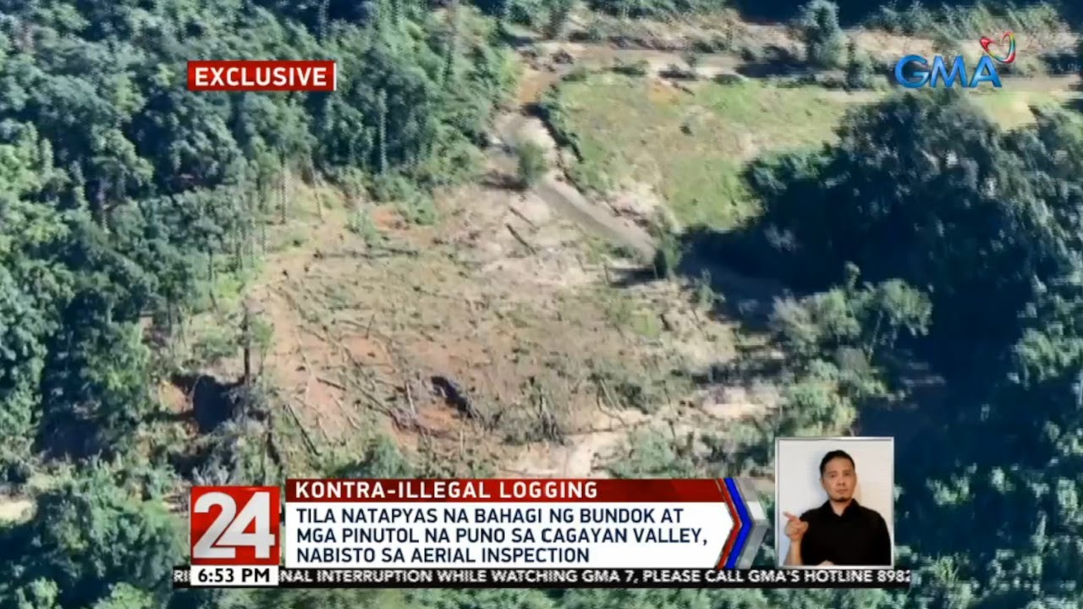
Regulated Timber
https://www.gmanetwork.com/

Slide 12

Responsible Fishing
https://coconuts.co/

Slide 13

Fresh Livestocks
https://akf.org.ph/

Slide 14
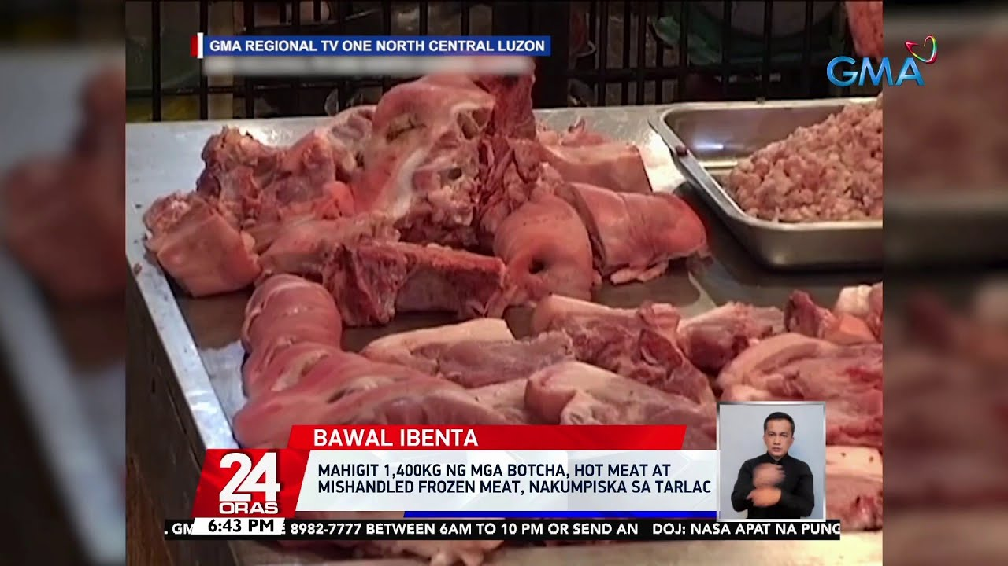
Fresh Livestocks
https://www.gmanetwork.com/

Slide 15
Modern Physical Capital

Slide 16
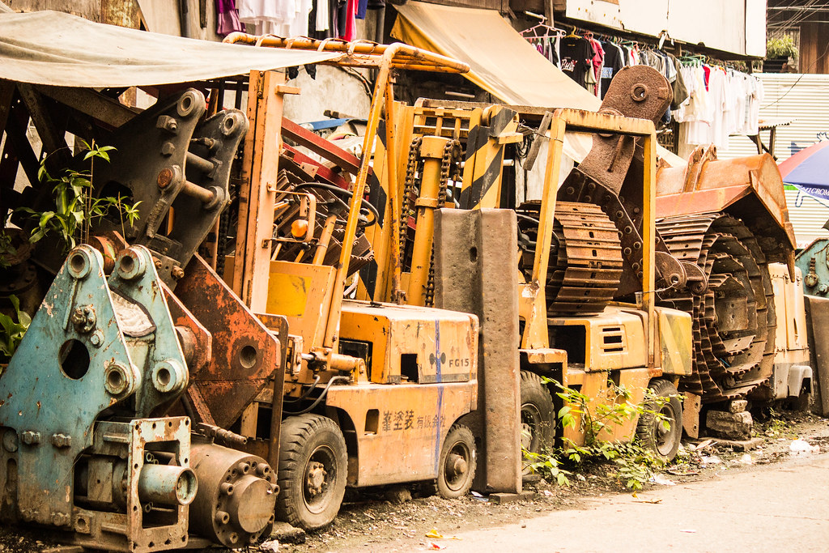
Heavy-duty Equipment
https://www.flickr.com/

Slide 17
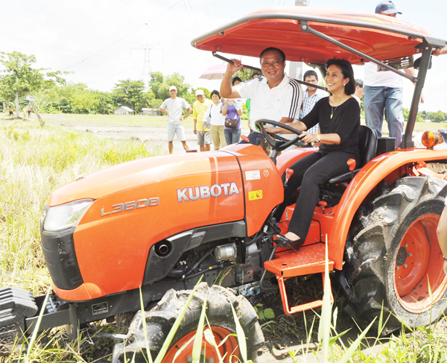
Modernized Machinery
https://pianormin.wordpress.com/

Slide 18
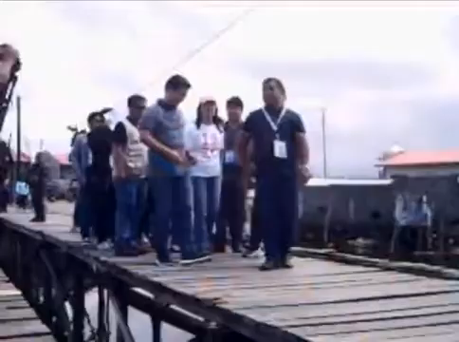
Sturdy Bridges
https://www.youtube.com/

Slide 19
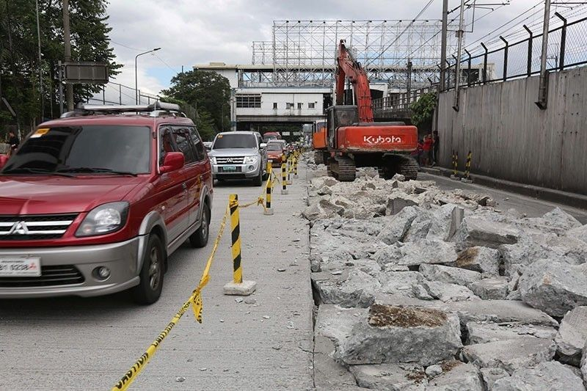
Accessible Roads
https://media.philstar.com/

Slide 20
Fair Labor and Human Capital

Slide 21
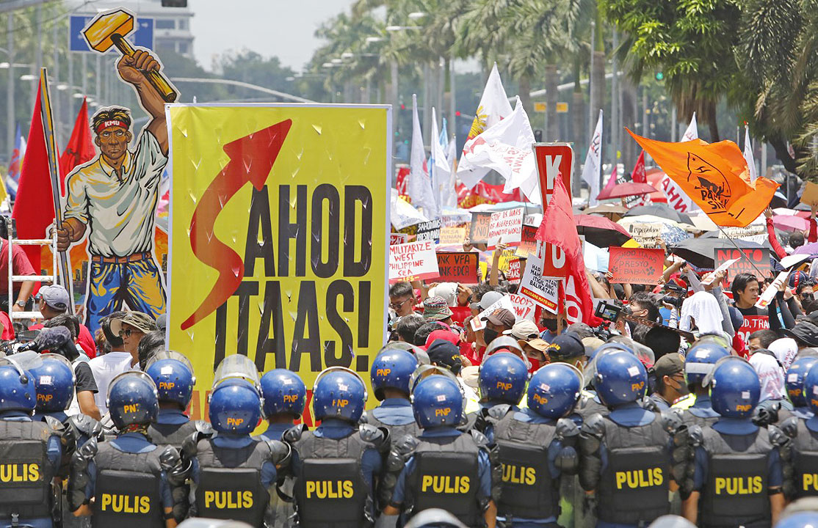
Contented and Motivated Laborers
https://www.bworldonline.com/

Slide 22
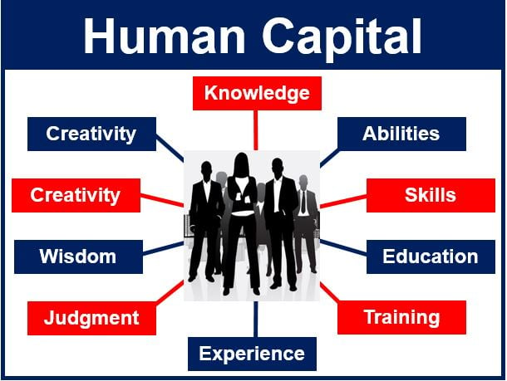
Expectation
https://marketbusinessnews.com/

Slide 23

Reality
https://www.youtube.com/

Slide 24
Functional Organization

Slide 25

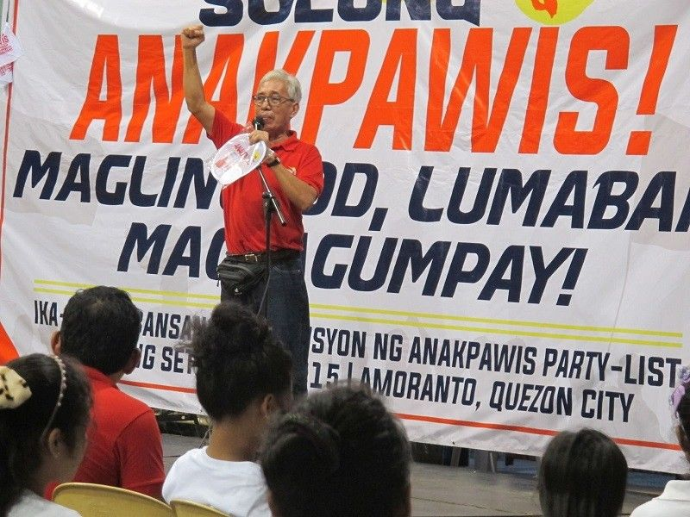
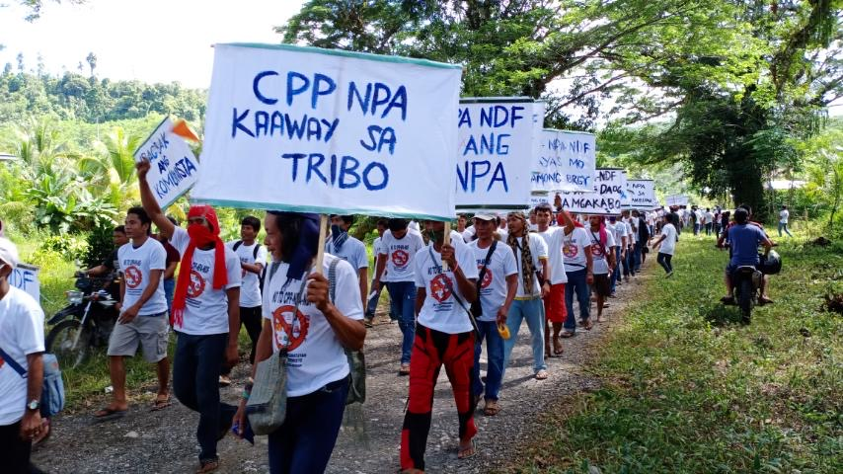
Management
http://lfsuplb.weebly.com/
https://www.philstar.com/
Sana all
well-managed
https://mb.com.ph/

Slide 26

Administration
Sana ma-manage
https://www.japantimes.co.jp/

Slide 27
Advanced Technology

Slide 28
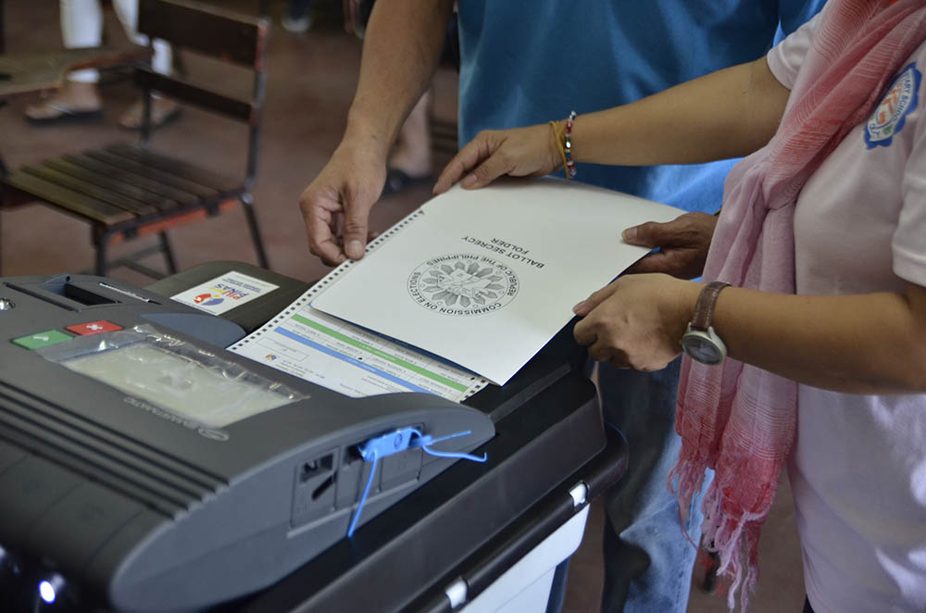
Automated Election
https://philippinerevolution.nu/

Slide 29
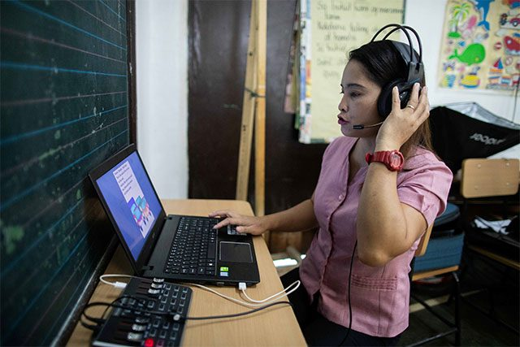
Technology in Education
https://interaksyon.philstar.com/

Slide 30
Scale (Economic Capacity, Structural Change)

Slide 31
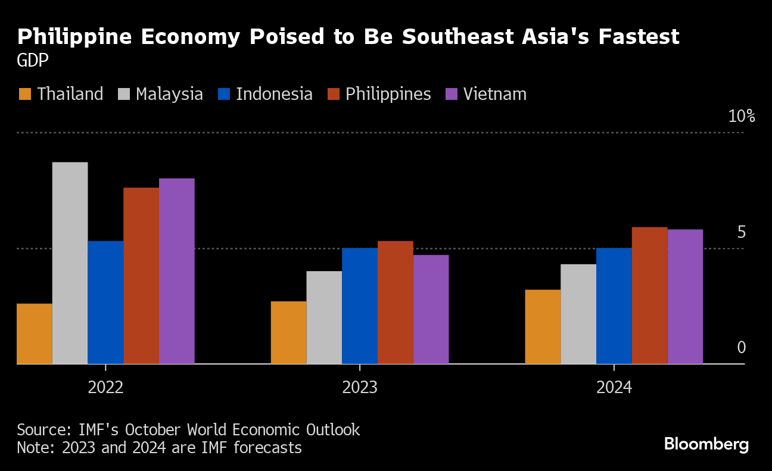
Economic Capacity
https://www.bloomberg.com/

Slide 32
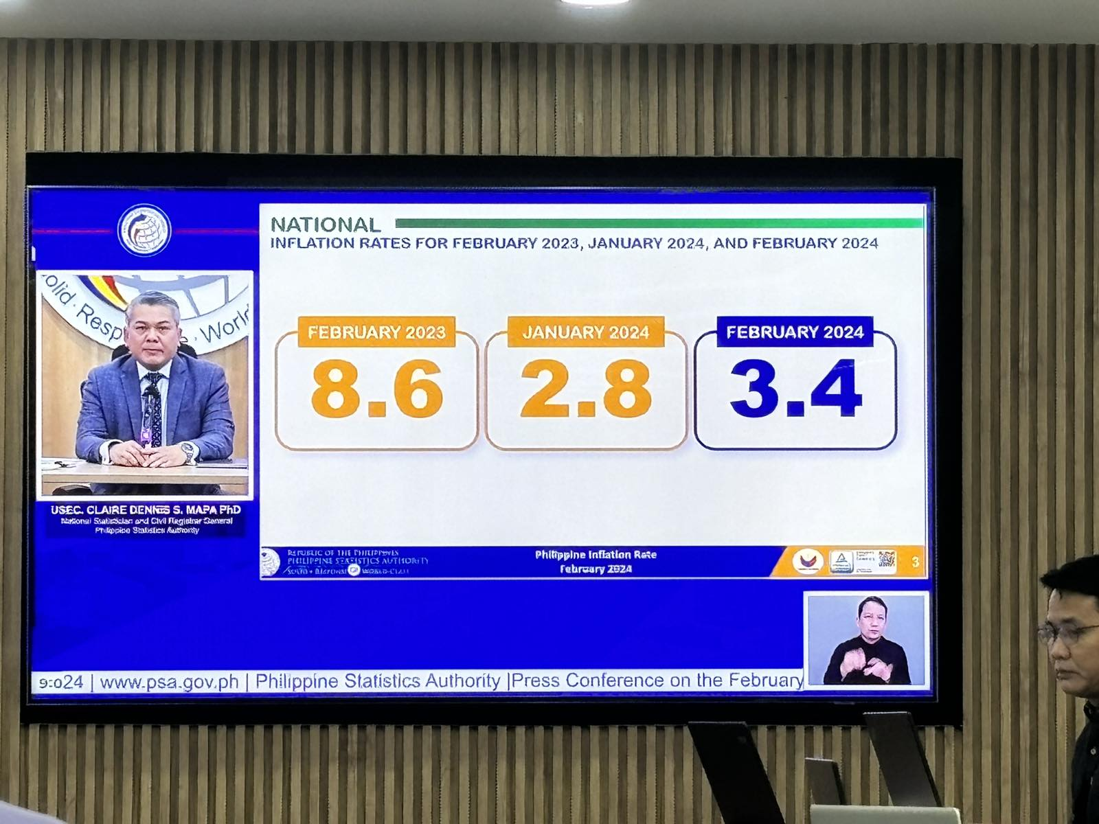
Structural Change
https://twitter.com/
Notes:
Structural change refers to a dramatic shift in the way an industry or market functions

Slide 33
Indicators and Determinants of Economic Development

Slide 34
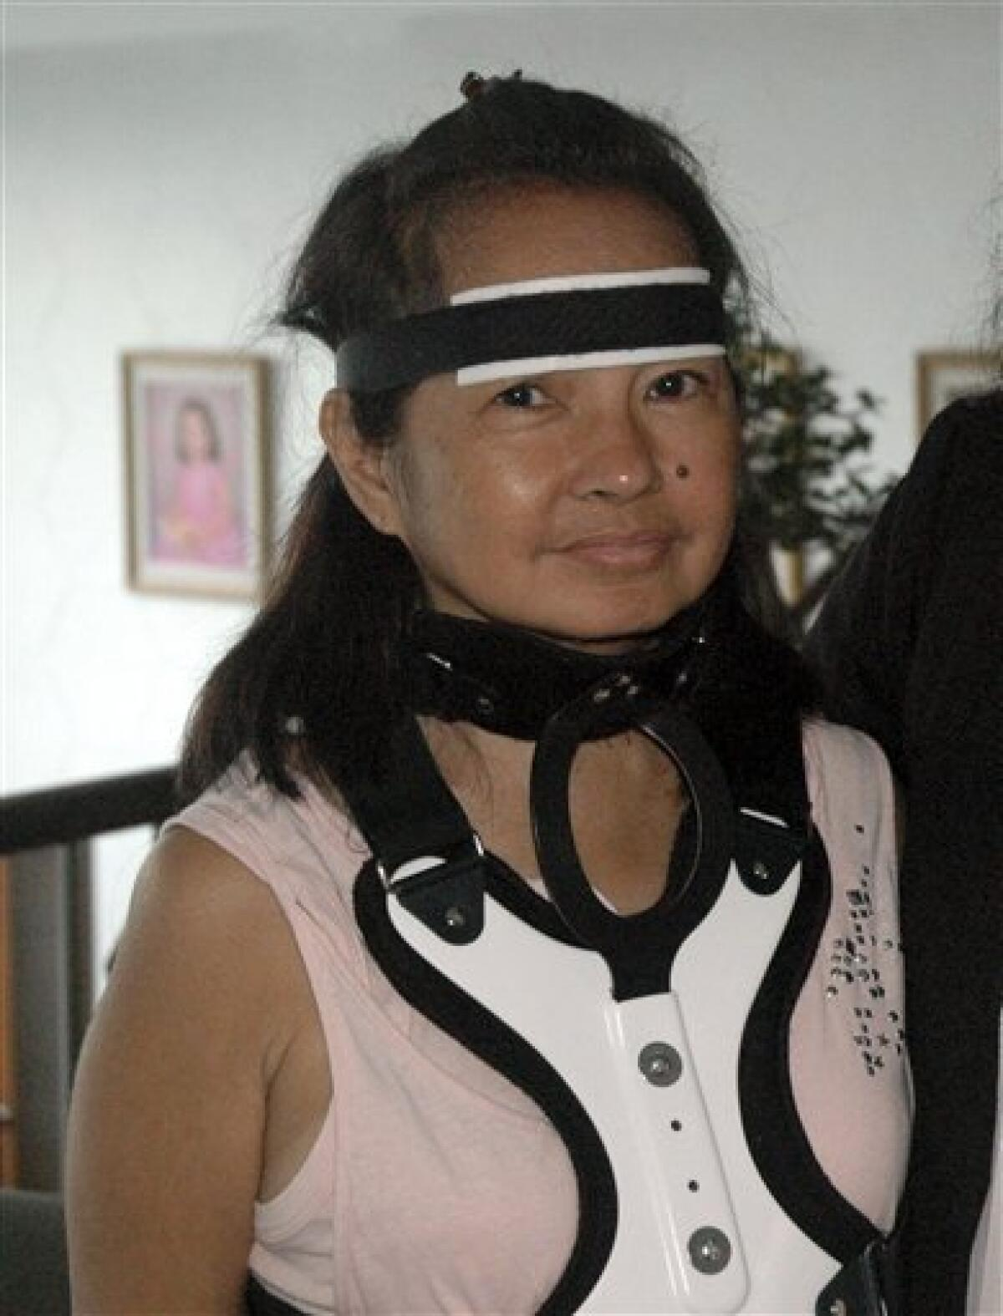
Healthy Citizens
https://www.sandiegouniontribune.com/

Slide 35
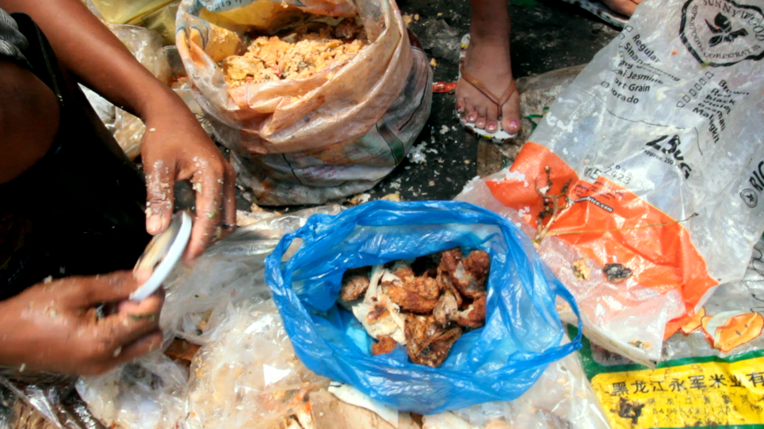
Nutritious Food Products
https://mealofthedaydoc.wordpress.com/

Slide 36
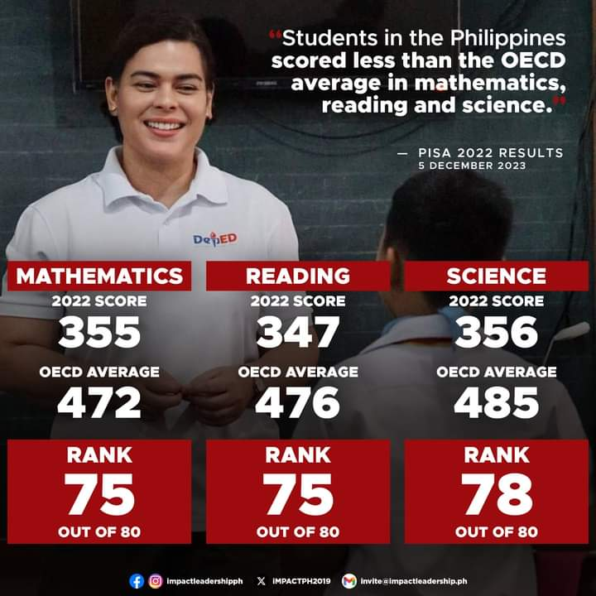
Impactful Learning
https://twitter.com/

Slide 37

Stable Income
https://9gag.com/

Slide 38

Increased Consumption
https://www.megabites.com.ph/

Slide 39
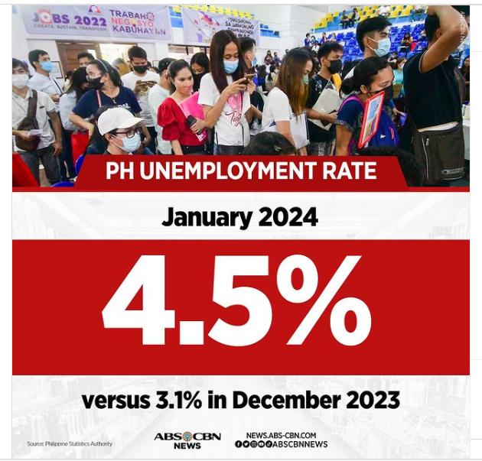
High Employment Rate
https://www.instagram.com/

Slide 40
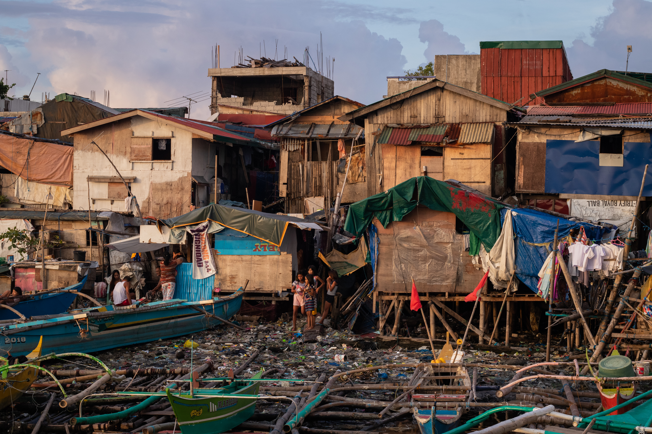
Adequate Housing
https://pulitzercenter.org/

Slide 41
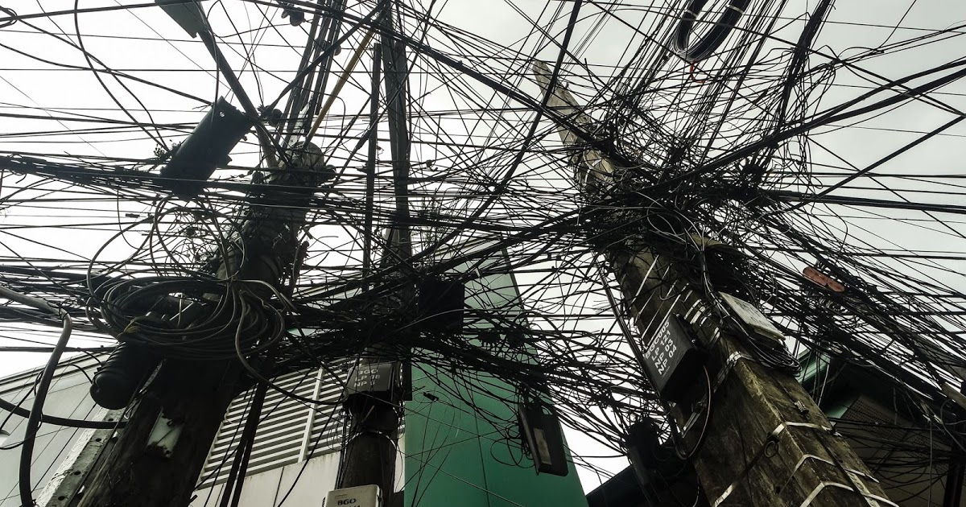
Accessible Utilities
https://engineerdee.com/

Slide 42
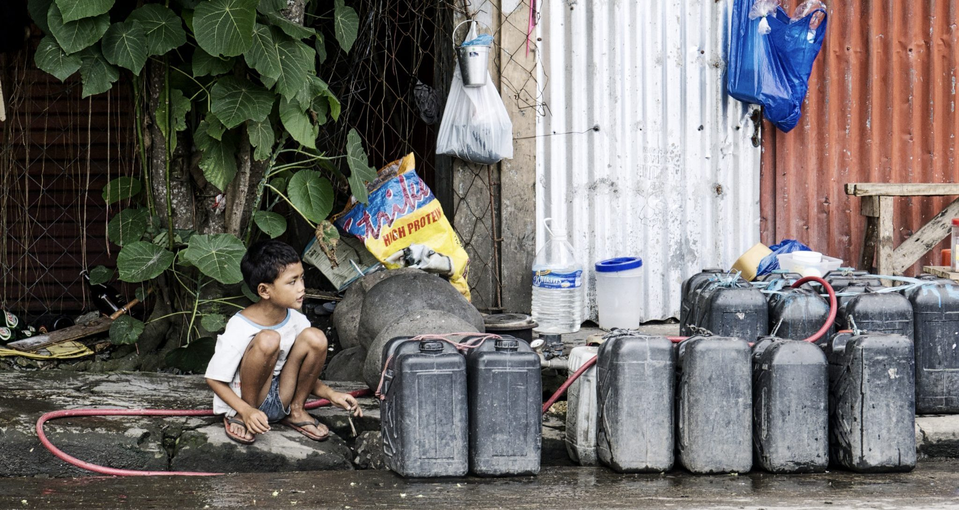
Sufficient Water Supply
https://www.engineeringforchange.org/

Slide 43
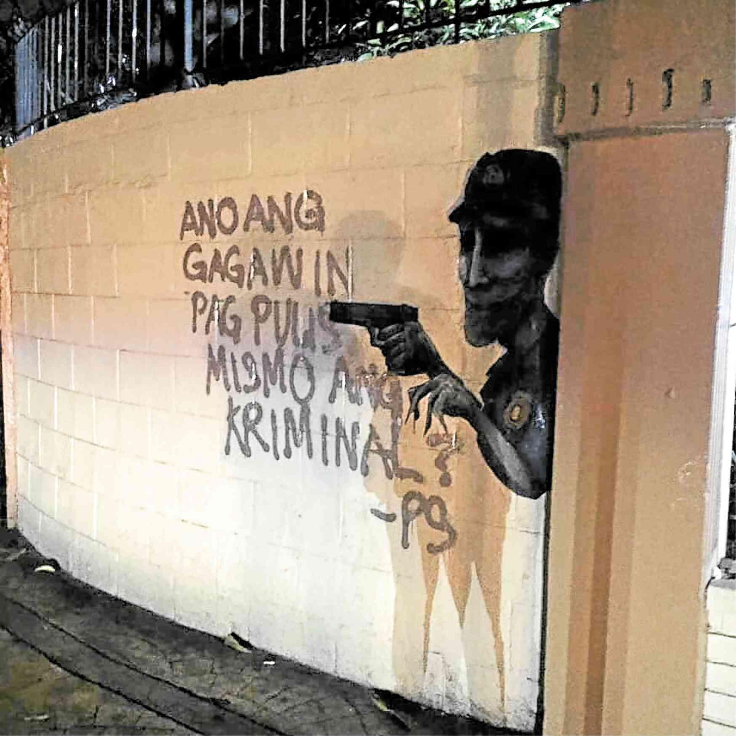
Safe Public Safety
https://newsinfo.inquirer.net/

Slide 44

Dynamic Political Values
https://twitter.com/

Slide 45

Equity in Social Mobility
https://foodphilippines.com/
Notes:
The change in a person's socio-economic situation

Slide 46
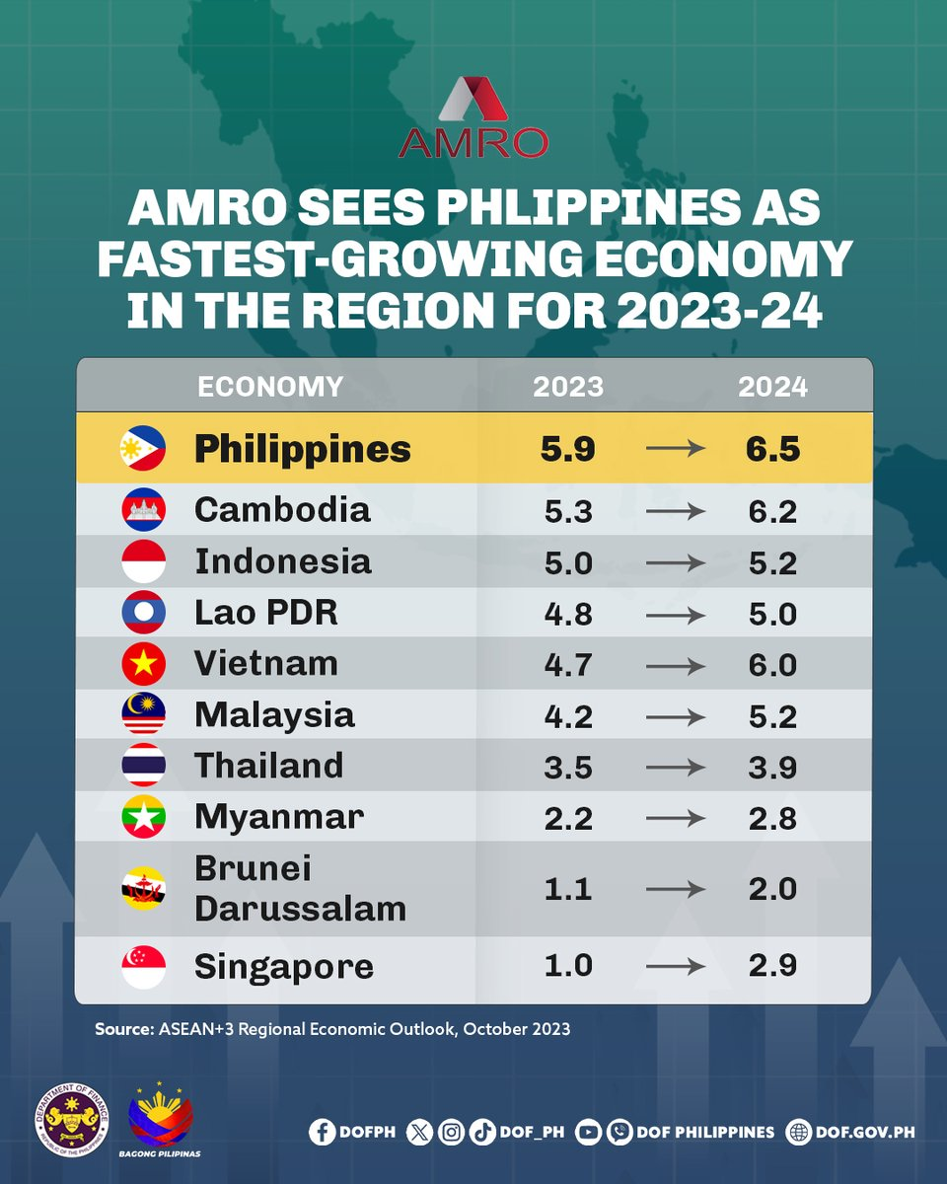
If this is the Philippines’ forecast
https://creativityprop.com

Slide 47
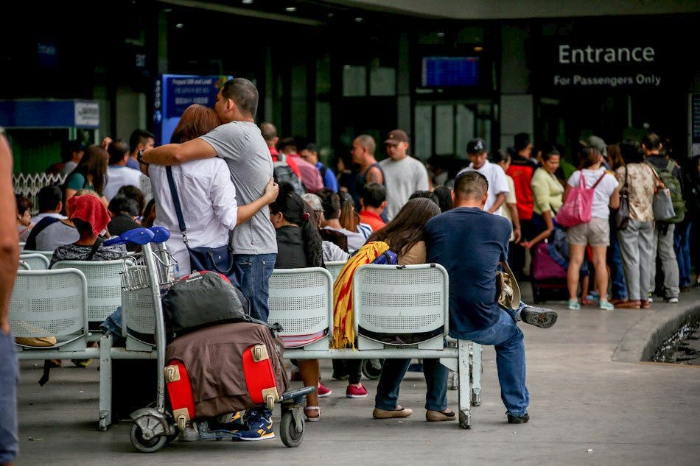
Why do they leave?
https://creativityprop.com

Slide 48
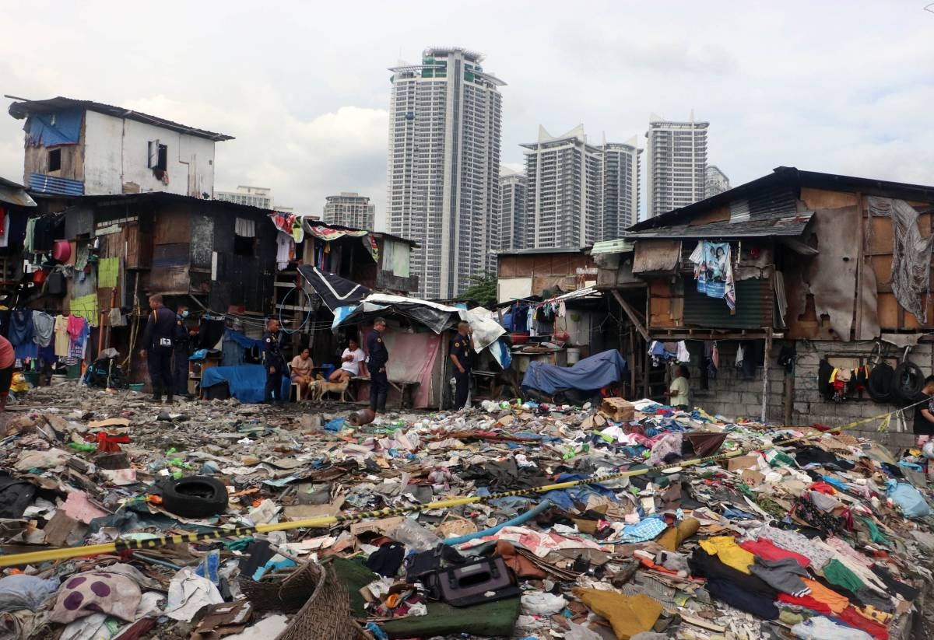
How do they live?
https://www.manilatimes.net/

Slide 49

Any suggestions?
https://stock.adobe.com/

Slide 50
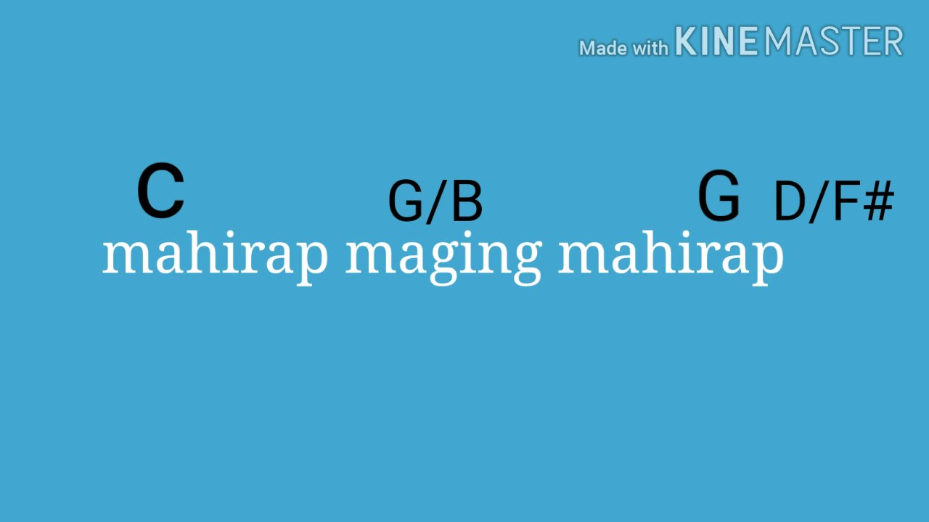
Dong Abay once said:
Mateo Singko by Dong Abay
https://www.youtube.com/

